Slide 1
Secure Data Hiding in Image Using Steganography
CAPSTONE PROJECT
Presented By: Sangam Gupta
Student Name : Sangam Gupta
College Name & Department : Dr. Ambedkar Institute of Technology for Handicapped Kanpur, Electronics Engineering

Slide 2
OUTLINE
Problem Statement
Technology used
Wow factor
End users
Result
Conclusion
Git-hub Link
Future scope

Slide 3
Problem Statement
The problem statement for "Secure Data Hiding in Image Using Steganography" revolves around the challenges and requirements of embedding sensitive or confidential information within digital images in a way that ensures security, privacy, and undetectability, while maintaining the quality and integrity of the original image.

Slide 4
Technology used
Software: PyCharm
Module: Cv2, os
Steganography

Slide 5
Wow factors
Provide High Security For Hiding Secret Message.
Easy operation.
Reflect fundamental concepts of cyber security

Slide 6
End users
Army
Organizations
Personal Use
Police Station

Slide 7
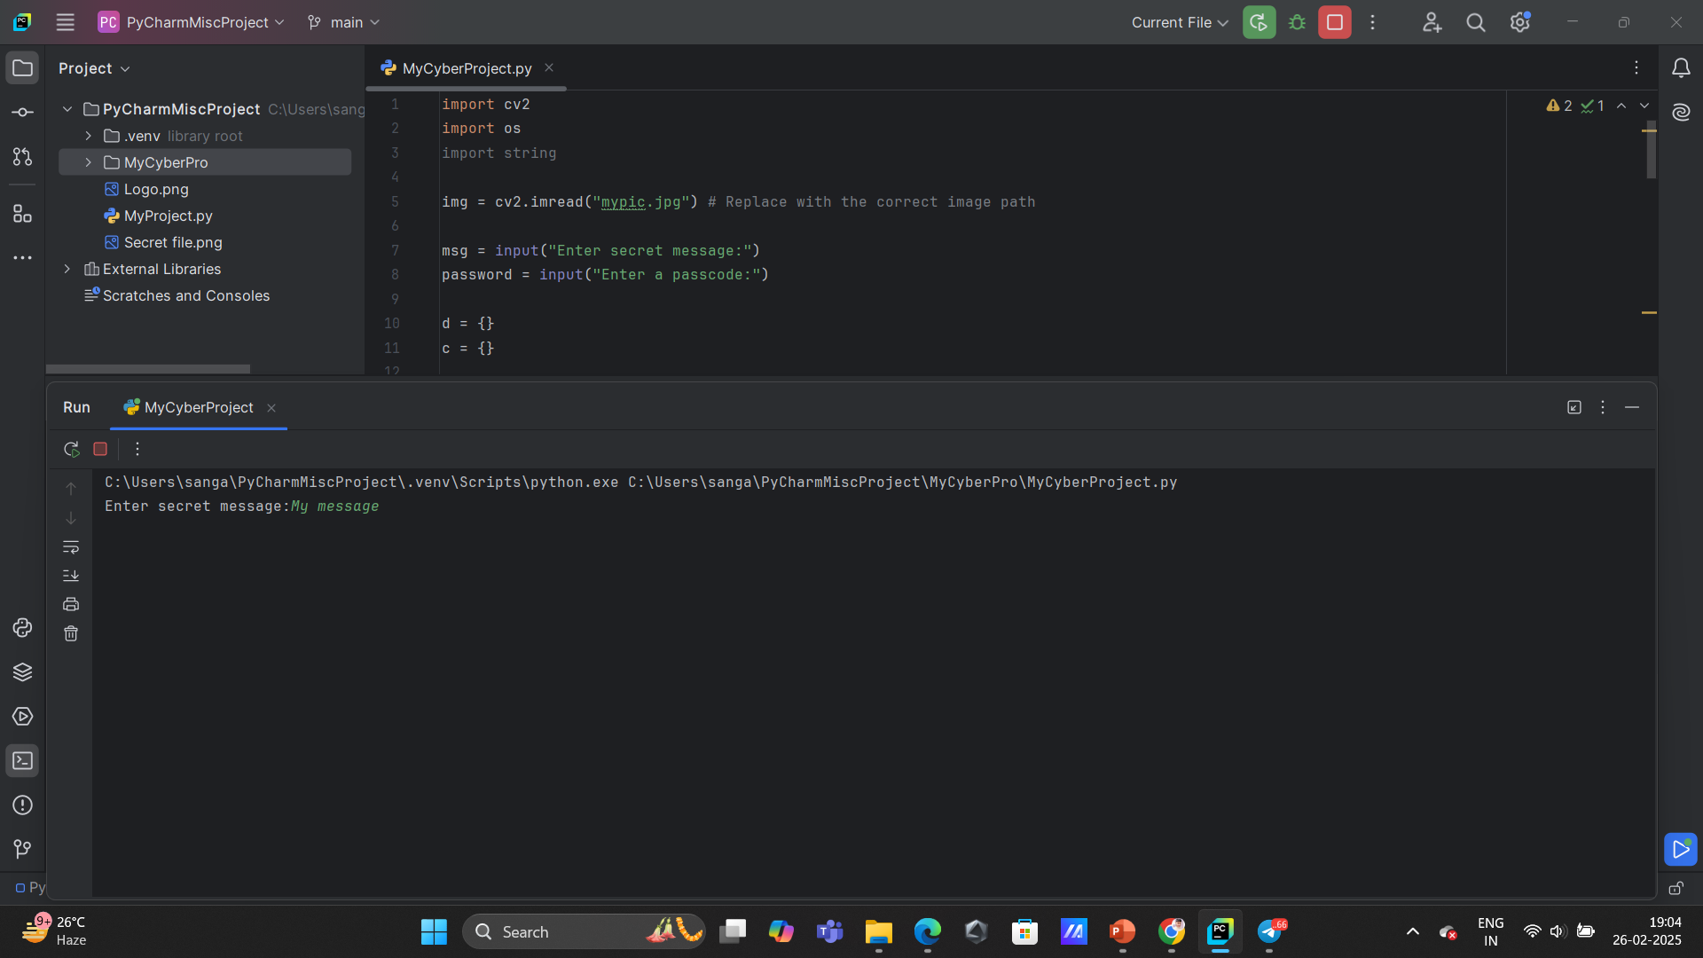
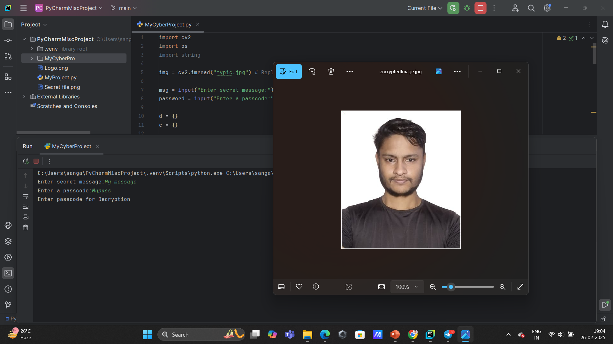
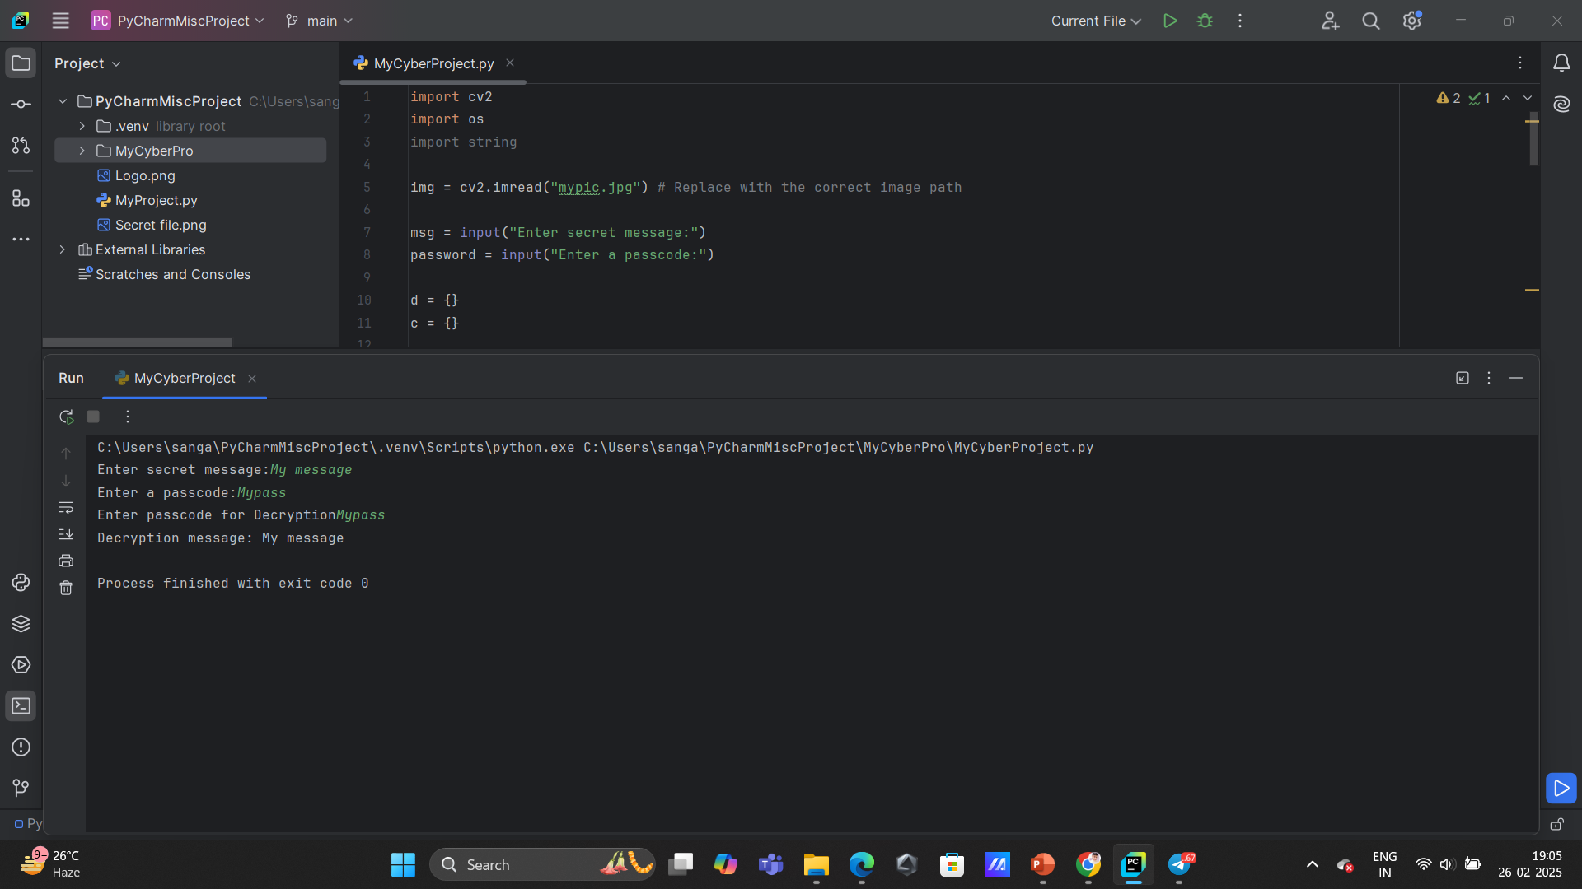
Results

Slide 8
Conclusion
The project "Secure Data Hiding in Image Using Steganography" successfully demonstrates an efficient and secure method of concealing sensitive information within digital images. By leveraging steganographic techniques, the project ensures data confidentiality while maintaining the integrity of the cover image. The proposed approach minimizes visual distortions, making it difficult for unauthorized individuals to detect hidden messages.

Slide 9
GitHub Link
https://github.com/Sangam-Gupta-f/CyberSecurityProject

Slide 10
Future scope(optional)
Quantum Steganography
Multi-Layer and Multi-Modal Steganography
Real-Time Steganography

Slide 11
THANK YOU

